Slide 1
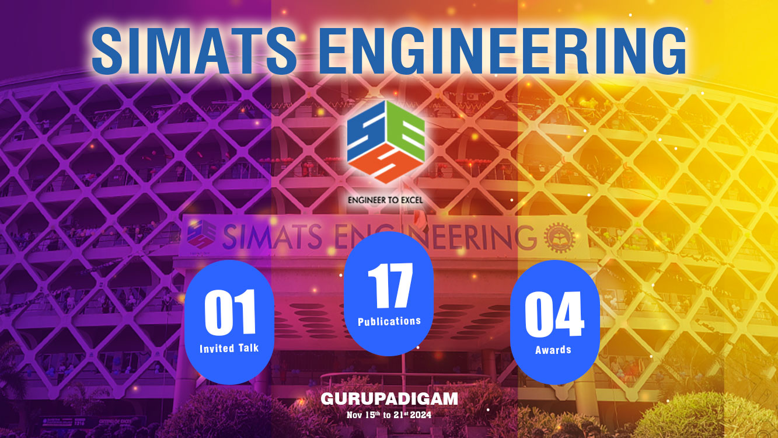

Slide 2
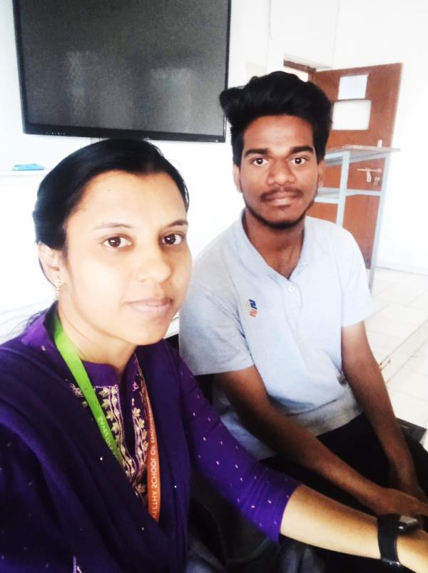
Student Name: BOSANI LOKESHWARA REDDY
Register No : 192311076
Mentor Name: Dr.R.Jeena Department : Department of
LogicNet
Mentee & Mentor Photo
Course Code/Name: CSA05/DATABASE MANAGEMENT SYSTEMS
Slot B | Total Marks | Marks Obtained | STATUS
Java Certification Exam | 100 | 74 | PASS

Slide 3
Dear Parent, Greetings!
Your ward is currently enrolled in the course Software Engineering and Operating System. He performed well in the Java certification exam conducted last week. His attendance is commendable, with 100% for Software Engineering and 100% for Operating System. We are pleased to see that he has been regularly attending classes, which is vital for his academic progress. We recommend that he also explore NPTEL courses to further enhance his knowledge. Participating in extracurricular activities such as symposiums, workshops, and technical events at other institutions can help him develop important skills like leadership, teamwork, time management, and problem-solving. Additionally, focusing on improving his communication skills would be beneficial.

Slide 4

MENTEE RESPONSE
PARENT’S RESPONSE
text
text

